Slide 1

Find Your Dublin
Group 1
Interim presentation

Slide 2

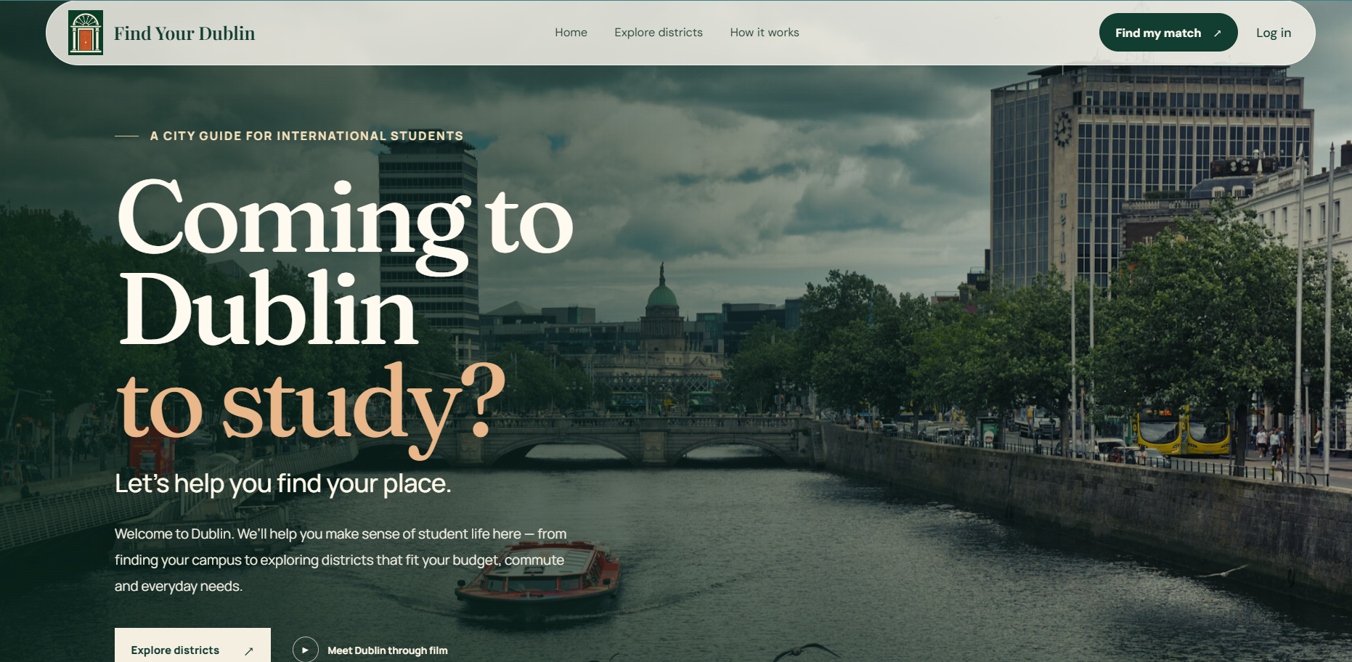
Project Vision
Build a Dublin District Recommendation System for international students choosing where to live.
Students enter their university, monthly budget, accommodation type and priorities.
The system ranks suitable Dublin districts with a match score and clear reasons.
It brings rent, commute, amenities and lifestyle information together in one place.
The aim is to help students compare areas confidently before contacting landlords.

Slide 3



Technology Stack
Frontend:
+
Log in → Your situation → Your priorities → Your matches
Results cards show match score, rent vs budget, commute, walking distance and why the area ranked there
District profile page with an interactive map (MapLibre + OpenFreeMap)

Slide 4



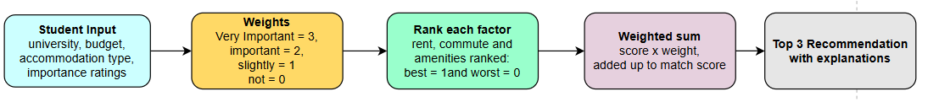
Backend and Recommendation logic

Slide 5



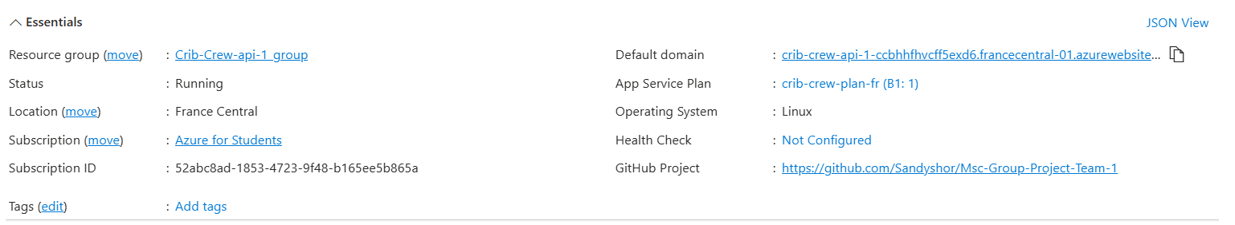
Deployment

Slide 6

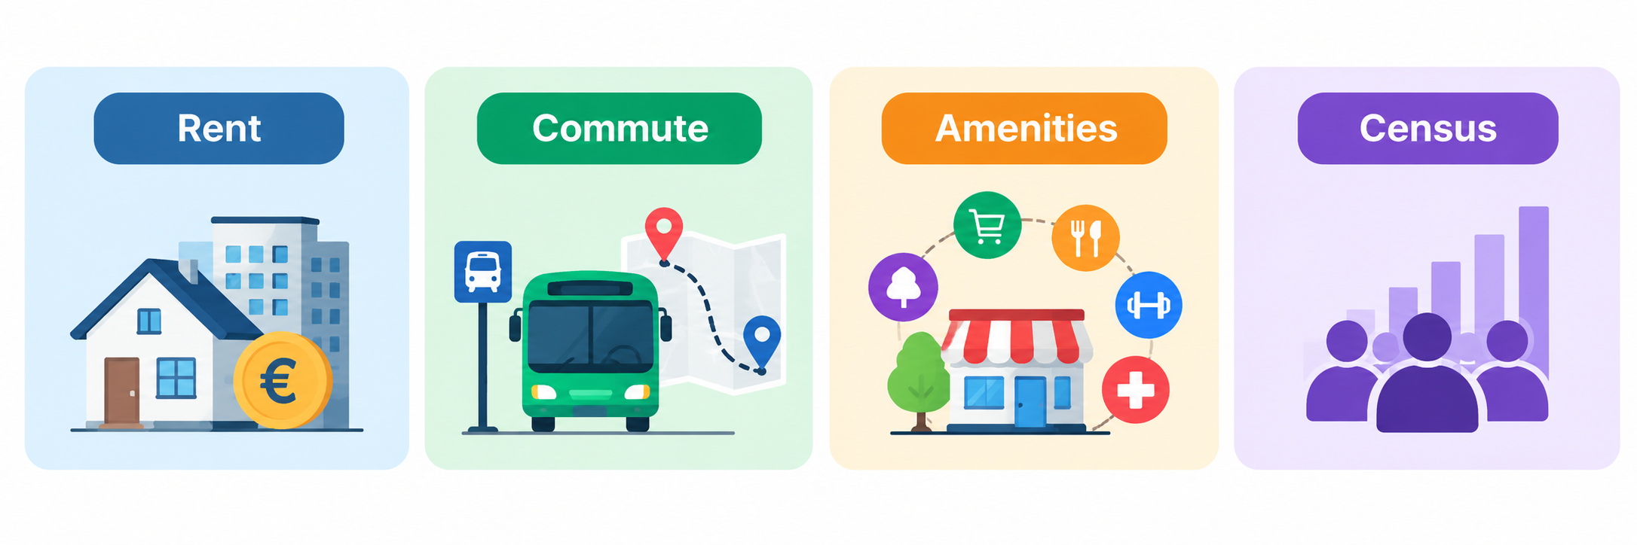
Data Stack
We need 4 main data for our recommendation engine.

Slide 7



Rent
RTB dataset was used to collect 1 bhk, 2 bhk, 3 bhk apartment type rent data from D1 to D24.
Daft.ie and Rent.ie was used to collect single sharing and double sharing room rents from D1 to D10 manually and organized it into an excel file.

Slide 8


Commute
Landmark Selection: Selected five landmark coordinates within each Dublin postal district and validated them against the Dublin postal district GeoJSON boundaries.
Route Calculation: Passed the validated coordinates to OpenTripPlanner (OTP) using Python code to calculate routes and travel times.
TFI GTFS: Provides public transport routes, stops and schedules.
OpenStreetMap (OSM): Provides the street and pedestrian network for walking routes.

Slide 9

Amenities
OpenStreetMap was used to scrap amenities from D1 to D24 that includes:
  Supermarkets & groceries
  Cafes
  Restaurants
  Asian restaurants
  Gyms
  Parks
  Pharmacies
  Hospitals
  Shopping malls

Slide 10

CSO Census
Collected:
  Population
  Age 20–29
  Student population
  Ethnicity/community profile

Slide 11

Evaluation
Today students find out about areas from Daft.ie, Rent.ie, Reddit, Facebook groups and YouTube
This takes time, and the advice is based on other people’s preferences
Our system will be successful if it gives the same information faster and more reliably
We evaluate it in four parts. Data, Algorithm, Performance and User testing.

Slide 12
What Success Looks Like
Goal | Measure | Target
Save users time | Time taken to reach a decision | At least 30% faster
Staying within budget | Top 3 recommendations close to the user’s budget | 100% of test cases
Accurate data | Displayed data checked against official sources | Commute within ±5 min, rent within 10%
Correct ranking | Test cases with known answers | All test cases pass
User agreement | Participants agree with the top recommendation | At least 75–80%
Easy to use | System Usability Scale (SUS) score | Above 68
Responsive | API response time on Azure | Around 2 seconds

Slide 13
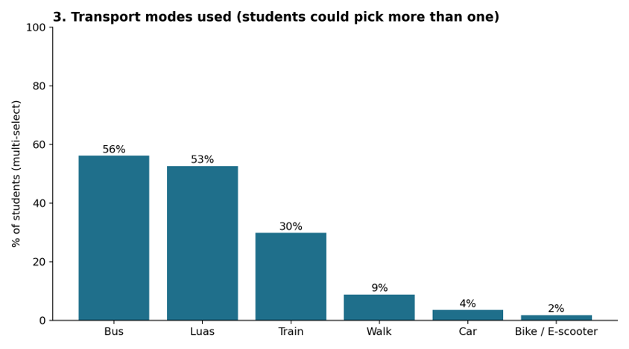
Student Survey on transport
We surveyed 59 students across TUD campus.
Asked where they live, how they get to college and what amenities are nearby
Bus 56%, Luas 53%, train 30%, so we use TFI journey times for commutes

Slide 14
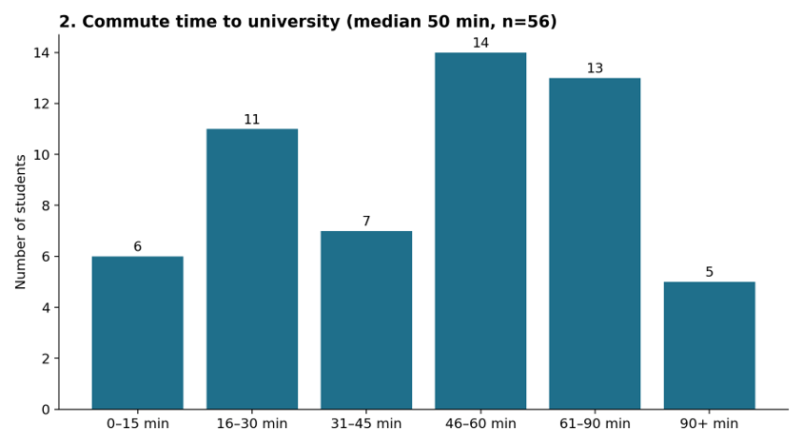
Student Survey on commute time
Median commute is 50 minutes (56 answers)
32 of 56 students travel more than 45 minutes.
Where a student lives has a big effect on their day

Slide 15
Checking the Data
Commute times: compare sample routes with TFI and Google Maps
Landmarks: corrected the ones that were placed in the wrong district
Rent: compare Daft.ie averages with RTB figures where there are few listings
Amenities: spot check counts in person or on Google Street View

Slide 16
Testing the Algorithm and API
Test cases with known answers
  If rent is top priority then cheapest area should comes first
  If commute is top priority then closest area comes first
  If no area within budget then user should gets a warning
  The explanation must match the score
Performance test on the Azure API
  Send 50–60 requests and record fastest, average and slowest
  Target is around 2 seconds; cold start will be measured separately

Slide 17
User Testing
Students who are new to Dublin
Each gets a scenario, or uses their own budget and university
Round 1: find an area using their usual sources
Round 2: find an area using Find Your Dublin
Afterwards: SUS questionnaire, do they agree with our top pick, how confident they feel, and what they would change or add

Slide 18
What We Do With the Results
Compare average decision time with and without our system
Work out the % of students who agree with our top recommendation
Group the feedback into common issues, missing factors, unclear explanations
Fix these before the final demo

Slide 19
Our Sprint Journey
Finalised our project idea
Identified target users
Created initial prototypes
Collected rent, amenities, commute and census data
Built initial recommendation logic
Conducted student survey
Expanded district data coverage
Developed frontend and backend
Integrated and Deployed in Azure
Sprint 1 - Planning and Design
Sprint 2 – Data and Logic
Sprint 3 – Build and Deploy

Slide 20
From Dublin Data to Useful Recommendations
Rental data – RTB, Daft.ie, Rent.ie
Amenities data – OpenStreetMap
Commute data – Google Maps, TFI GTFS
Census data – CSO demographics
Rent, Commute, Groceries, Restaurants,
Parks, Gyms, Pharmacies, etc
D1 TO D24
INPUT
Student preferences + district datasets
Recommendation Engine
scores, ranks and recommends suitable areas

Slide 21






A working web application
Frontend - React
Backend – Azure
Homepage
Landing page and video
Questionnaire
Student preferences
Login / Sign-up
User access interface
District Explorer
Maps and area profiles
Here’s the link to our website - Find-your-Dublin

Slide 22

Immediate Next Steps
Integrate all components: Connect the recommendation algorithm, student input form, district profiles and interactive map.
Validate recommendations: Check match scores, district rankings, rent values and automatically generated explanations.
Complete and test the interface: Improve navigation, district information, famous-place images and Luas connections.
Prepare user testing: Create realistic student scenarios and prepare feedback questions for international students.
PostgreSQL database integration: Migrate and organise existing datasets in PostgreSQL to support structured storage, efficient querying and integration with the recommendation system.
AI chatbot development: Develop an AI-powered chatbot to answer student queries, explain district recommendations and help international students compare suitable areas.
System integration and testing: Connect the PostgreSQL database and AI chatbot with the existing components and test the complete system for functionality and usability.

Slide 23

PROJECT ROADMAP
Three two-week sprints to deliver a tested recommendation system for international students.
SPRINT 4:
Test with 10-15 international students.
Evaluate recommendation quality and usability.
Collect feedback on usefulness explanations and interface.
SPRINT 5:
Improve the system based on feedback
Finalise documentation and presentation
Prepare for final submission
SPRINT 6:
Implement an AI chatbot to answer students questions about Dublin districts.
Integrate the chatbot with the recommendation system to provide guidance on suitable areas.
Test chatbot responses and improve usability based on feedback.
FINAL GOAL: A working tested and explainable district recommendation system that helps international students find the right area to live in Dublin.

Slide 24


